Slide 1
Latin 1: Chapter 4
2nd declension neuter nouns; Dative Case; 1st and 2nd Dec. Adj.

Slide 2
2nd declension neuter nouns (pg. 60)
Like 2nd declension masculine nouns, all 2nd declension neuter nouns are identified as belonging to the 2nd declension by a “-i” in the genitive singular.
It is important to note that all neuter nouns, adjectives, and pronouns in Latin are the exact same word in the nominative as they are in the accusative!!!

Slide 3
2nd Declension neuter nouns
Venenum, Veneni (n)- poison
Singular Plural
Nominative Venenum Venena
Genitive Veneni Venenorum
Dative Veneno Venenis
Accusative Venenum Venena
Ablative Veneno Venenis

Slide 4
Dative Case (pg. 62)
The Dative Case is used for the indirect object in the sentence (indirectly receives the action of the verb)
Translate into English as to/for
Usually follows verbs of giving, telling, or showing

Slide 5
Dative Case
You ought to give me a great reward!!!
This can also be reworded as…
You ought to give to me a great reward!!!
Me indirectly receives the action of the verb and is therefore the indirect object in the sentence. In Latin, the indirect objects are always in the dative case.

Slide 6
Dative case
He does not give a reward to the deserter, but chains.
Praemium non dat profugae, sed vincula.

Slide 7
1st and 2nd declension adj. (pg 64)
1st and 2nd Declension Adjectives can be recognized in a Latin dictionary by having the first form of the adj. ending in a “-us”, the second ending in “-a”, and the third ending in a “-um”.
The “-us, -a, -um” endings which allow you to identify a 1st and 2nd declension noun in the dictionary stand for the nominative singular forms for 2nd declension masculine nouns (-us), 1st declension feminine nouns (-a), and 2nd declension neuter nouns (-um)

Slide 8
1st and 2nd declension adj.
In Latin, all adjectives must agree with their nouns in case, number, and gender.
This is the only way to determine if an adjective is modifying a Latin noun or not. NOT PLACEMENT OR WORD ORDER!!!
All 1st and 2nd declension adj. are fully declined just like all the 1st and 2nd declension nouns (see pg. 64).

Slide 9
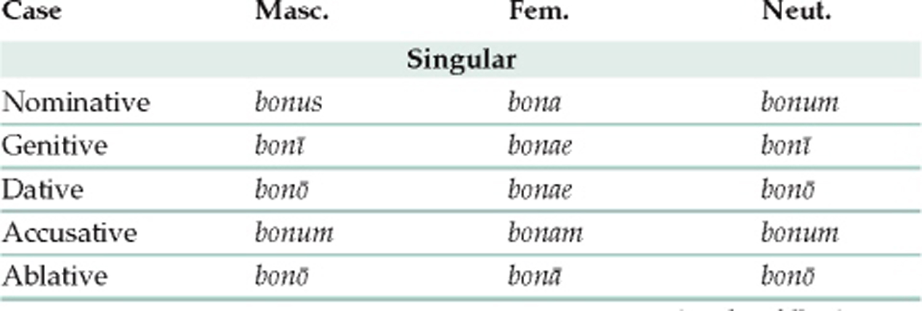
1st and 2nd declension adj.

