Slide 1
Chapter 14
1st and 2nd Conjugation: Future Tense
Future Tense of Sum & Possum
Relative Clauses/Pronouns

Slide 2
1st and 2nd Conjugation Verbs: Future Tense
Uses the same stem as the present and imperfect tense (1st principal part, remove the o).
Add the appropriate linking vowel according to the conjugation.
Add the endings…

Slide 3
Future/Active Endings
Singular Plural
1st -bo -bimus
2nd -bis -bitis
3rd -bit -bunt

Slide 4
Future/Passive Endings
Singular Plural
1st -bor -bimur
2nd -beris -bimini
3rd -bitur -buntur

Slide 5
Amō, amāre (future/active)
Singular Plural
1st amabo amabimus
2nd amabis amabitis
3rd amabit amabunt

Slide 6
Habeō, habēre (future/passive)
Singular Plural
1st habebor habebimur
2nd habeberis habebimini
3rd habebitur habebuntur

Slide 7
Future of Sum, esse, fui, -----
Singular Plural
1st ero erimus
2nd eris eritis
3rd erit erunt

Slide 8
Future of possum, posse, potui, -----
Singular Plural
1st potero poterimus
2nd poteris poteritis
3rd poterit poterunt

Slide 9
Translations
Translating the future tense into English either with “will” or “shall”.
E.g. Amabunt = They will love
E.g. Amabimini= You all will be loved

Slide 10
Relative Clauses
Relative clauses are subordinate clauses which begin with a relative pronoun and end either where it makes sense to end (English), or with the verb (Latin).
N.B. Remember that subordinate clauses (a.k.a. dependent clauses) rely upon another clause or part of a sentence in order for it to make sense.
E.g. I do not like the baseball player who is unable to get on base.

Slide 11
Antecedents
All pronouns, including relative pronouns, refer to another word which is called an antecedent. In Latin, relative pronouns always agree with their antecedents in number and gender. They do not agree in case because the relative pronoun can have its own grammatical function within its clause.
Magister amat discipulos {qui acres erant}.
The teacher likes his students {who were smart}.

Slide 12
Relative Pronouns
In English there are 5 Relative Pronouns:
Who (Latin = Nom.)
Whose (Latin= Genitive)
Whom (Latin= Genitive/Dative/Accusative/Ablative)
That (Latin= Nominative/Accusative)
Which (Latin = all cases)
In Latin there are 30…

Slide 13
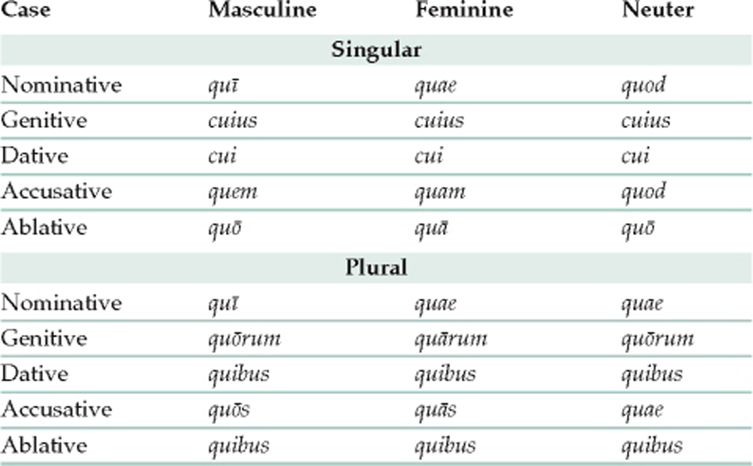
Latin Relative Pronouns

