Slide 1
Early Roman Republic
509-265 BCE

Slide 2
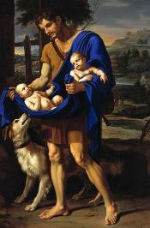
King romulus
First of the seven kings of Rome
Killed his brother Romulus to become sole ruler of Rome
Ruled bilaterally with a Sabine named Titus Tatius. Their rule together was short lived
One day in the Senate which was founded by Romulus, (100 elders as advisers) a cloud enveloped around Rome’ first king. When the cloud dispersed, the ruler was nowhere to be found.
Was he assassinated by the Senate?
Was he carried off to live with the gods as the god Quirinus as the Senate proclaimed?

Slide 3
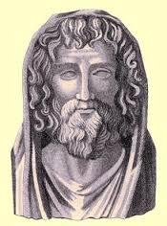
Kings after romulus
After Romulus were six other kings.
They were all of Etruscan descent.
Numa Pompilius was Rome’s second king.
He established the state’s laws and religion.

Slide 4
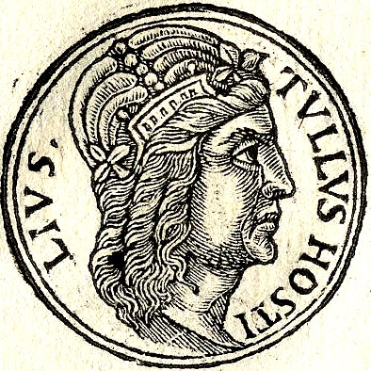
Tullus hostilius
As his name implies, the 3rd king of Rome was known for waging wars.
This is where the Romans attribute their warlike nature and condition.

Slide 5
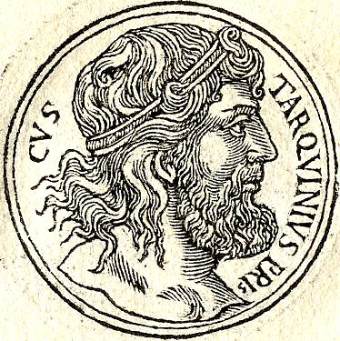
Ancus marcius and tarquin priscus
The fourth and fifth kings of Rome
Ancus Marcius is infamously known for the fatal decision of appointing Tarqui Priscus as the tutor of his sons.
Later, Tarquin Priscus usurped the throne from his pupils.
Thus began a long and malicious stretch of the Tarquin family.

Slide 6
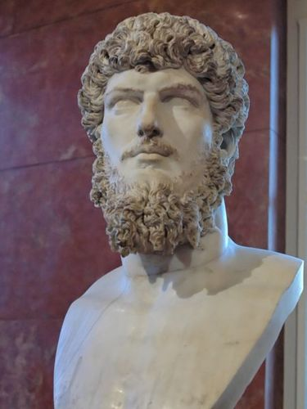
Servius tullus and tarquin superbus
The final two kings of Rome
Servius Tullus married the daughter of his predecessor, Tarquin Priscus.
Later, he was murdered by his own son-in-law, Tarquinius Superbus, who became Rome’s final king.
Superbus = haughty
Superbus’ son’s lustful and malicious acts are what led to the end of the Roman monarchy

Slide 7
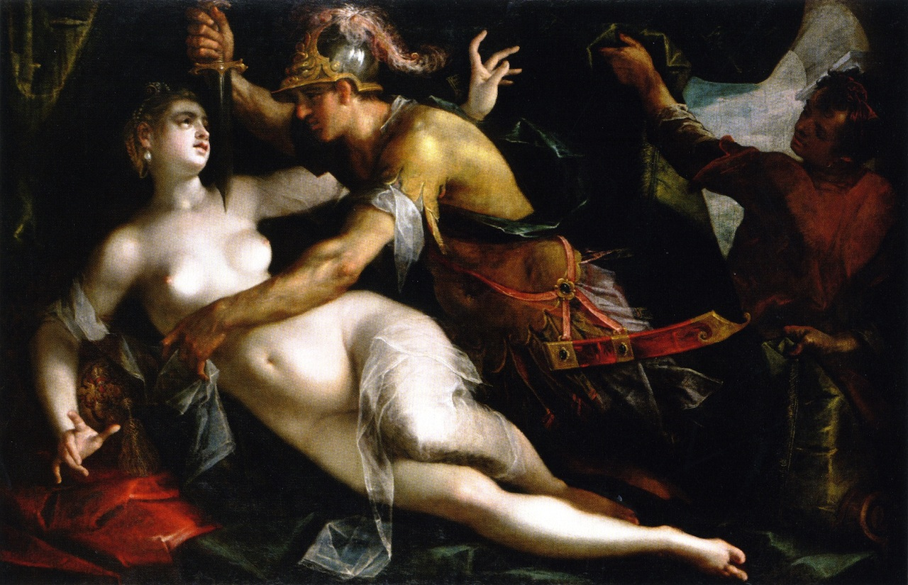
Rape of lucretia and the end of the roman monarchy
Superbus’ son, Sextus, fell in a state of uncontrollable lust for the wife of a Roman named Collatinus (her name was Lucretia Collatinus).
Sextus lusted for her not only because of her beauty, but because of her upright moral nature as well.
In the middle of the night in Collatinus’ home, Sextus held a knife to Lucretia’s throught and raped her.
Having falling victim to pudor Lucretia informed her father and her husband, Lucius Junius Brutus, what had happened. After her confession, she took her own life.

Slide 8
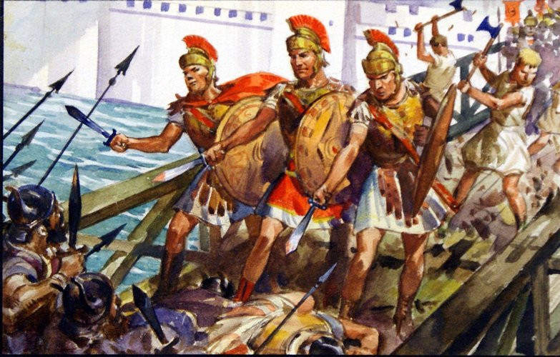
Aftermath of lucretia’s death
Lucius Junius Brutus and Lucretia’s father drive Tarquin Superbus and the last of the Etruscan kings from Rome.
Superbus flees to Lars Porsenna, king of Clusium (just north), to seek reinforcements from his Etruscan allies.
The Etruscan armies of the Tarquins and Porsenna march on Rome with 90,000 men where they encounter an amazing soldier Roman advocate.
As the Etruscans approach Rome, the Tiber floods. One man, Horatius Cocles, then knew how to save Rome.

Slide 9
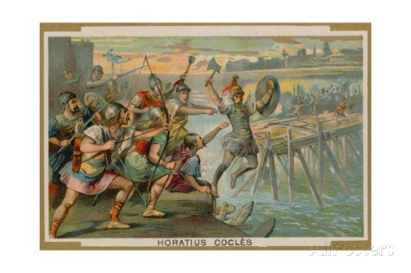
Horatius cocles and the pons sublicius
Horatius Cocles ordered the Roman army to hack down the Pons Sublicius which the Etruscans would attempt to cross.
In the meantime, Cocles, accompanied by only two other men in order to preserve their pudor defend the bridge as the Romans hack away.
The two retreat in time, but not Cocles. As the bridge collapses into the Tiber, so does he. Fully armed, he is washed up onto the banks of Rome.

Slide 10
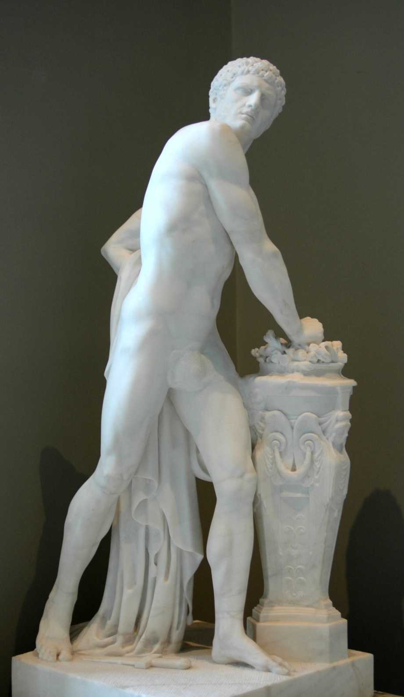
Gaius Mucius “scaevola”
Porsenna knew that eventually the wildest of rivers settles down after awhile.
He surrounded Rome and waited for the Romans to come out of the city knowing that eventually they would starve.
On account of his hatred of the Etruscans, Gaius Mucius asked the Roman Senate for permission to be released from the city in order to kill the Etruscan king.
After he was awarded permission, Mucius killed one of the Etruscan sentries, donned his armor, and sneak behind enemy lines.

Slide 11
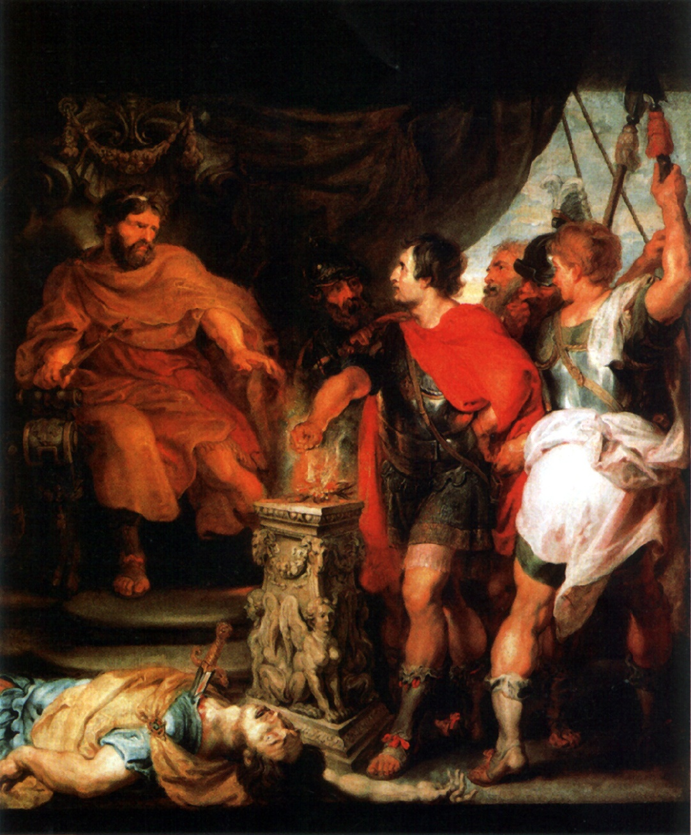
Scaevola: an act of audacity and bravery
Not knowing what the Etruscan king looked like, he searched for a silk tent in the middle of the camp.
Having killed a few sentries in front of the king’s tent, he was dragged into the tent by some Etruscan soldiers.
Not taking kindly to the threats of Mucius, king tried to force information from the Roman by placing his left hand over a burning brazier.
Knowing not what to do with him, Porsenna released Mucius.
The Senate gave him land across the Tiber (known as the Mucian Meadow)
He was given the nickname “Scaevola” meaning left-handed (since his right was mauled by fire).

Slide 12
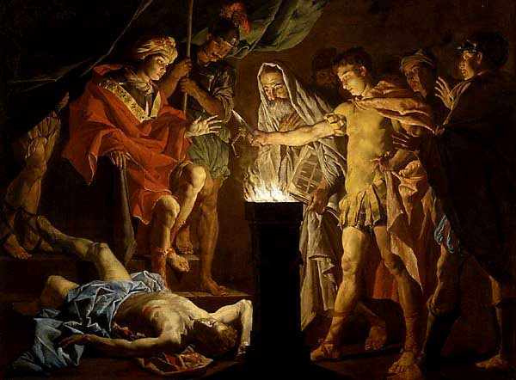
Conditions of Peace
Thinking that Horatius and Scaevola were all that Rome had to offer, Porsenna aimed for peace.
The Tarquins, cousins of Porsenna, wanted their line of kings to be restored. The Romans refused.
Porsenna lifted the siege in turn and gave back some of the land and hostages to the Romans.
One of them was a woman who demonstrated that audacity was not isolated only to Roman men…

Slide 13
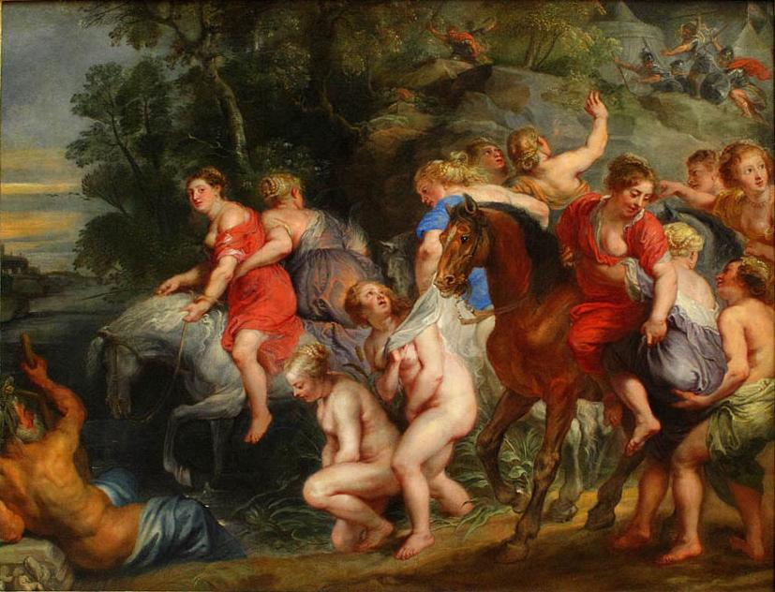
CLOELIa
The Roman matron Cloelia led a group of Roman women across the Tiber despite the Etruscan arrows.
He ordered the woman be returned to him. Having sent his messengers out, his heart grew soft for the woman. His new condition for the Romans was that if she were returned to him, that she would not be harmed.
Upon arival in the camp, Porsenna, having admired Cloelia’s courage told her that she could take half of the hostages back with her.
She took back with her vulnerable young children, especially boys. The Romans rewarded her with an equestrian statue at the head of the Via Sacra.

Slide 14
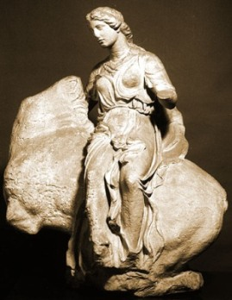
Statue of Cloelia in the via sacra
Realizing that he had greater business to deal with in Clusium, Porsenna left Rome and his cousins, whom he realized he never liked too much anyways, to their own fate. ☹

Slide 15
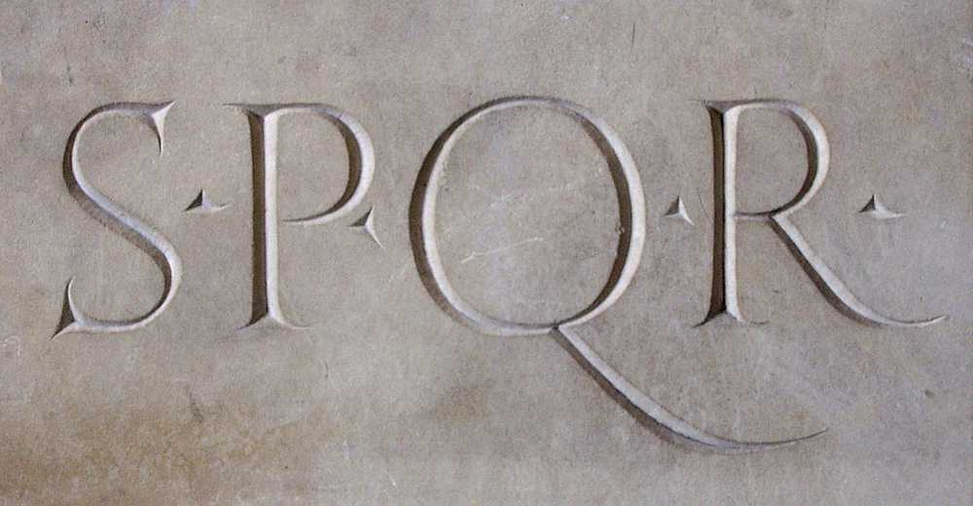
Rome as a republic
With Porsenna and the Tarquins gone, Rome became a Republic; a government in which all citizens are equal.
However, the idea of equality quickly became a different reality.
Rome’s most wealthiest and powerful citizens, known as aristocrats, took control of the state and its affairs leaving the plebs to mundane tasks in which the aristocrats had no interest in.
The plebs paid taxes and fought in the army. However, the plebs quickly realized that they had one thing the aristocrats did not: numbers.

Slide 16
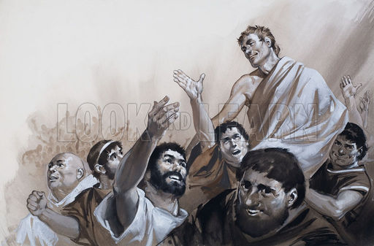
Rebellion
Early in the Republic a skirmish flared among the plebs which gave great concern to the powerful aristocrats.
With the plebs fleeing to the mountains, the aristocrats send Menenius Agrippa, a man with a persuasive tongue, to talk the plebs back to Rome.
He told a story to the plebs about a human body whose parts went on strike against the stomach because they all worked to feed it, while it did nothing but eat.
The plebs agreed, but not before they negotiated to have representation in the Senate; a Tribune of the Plebs, an office with veto power and immunity.

Slide 17
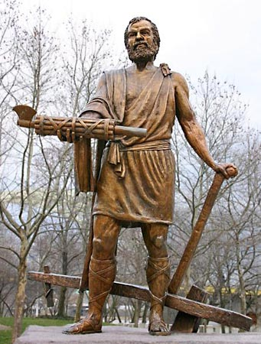
A Dictator: lucius quinctius cincinnatus
In 458 BCE, the consuls Nautius and Minucius set out to take care of two neighboring tribes: the Aequi and the Sabines.
Munucius, once encamped in Aequi terrority, refused to leave his site. Having recognized this, the enemies besieged the camp. Five horseman managed to flee and relay the message to the Senate in Rome.
The Senate appointed a legal dictatorship (a six month office) to Cincinnatus to handle the problem. When messengers from the Senate went to Cincinnatus, they found him tending to his fields.
Having put on his toga (a sign of dignity) as we he was requested by Roman curriers, he set aside his plow and marched with his recruits.

Slide 18
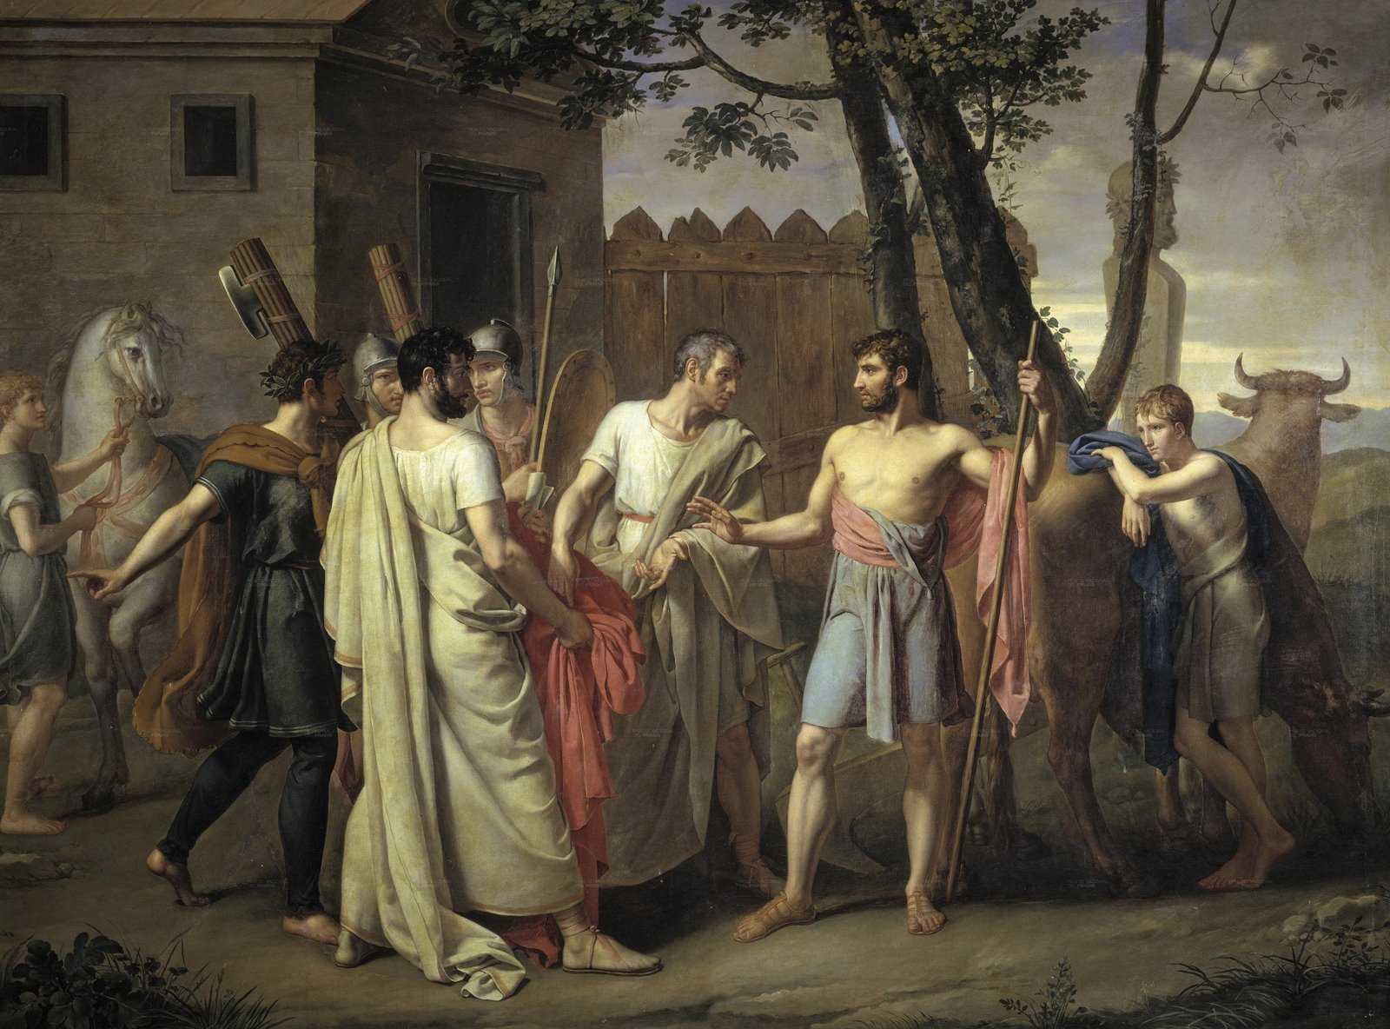
A true dictator
When the army of Cincinnatus arrived, the Aequi found themselves in a “sandwich”. When the soldiers of Minucius heard a Latin cry, they charged forth. Roman sword eventually meet Roman sword, and Cincinnatus had his victory.
Upon his triumphant return, Cincinnatus set aside his role as dictator and took back up his plow.

Slide 19
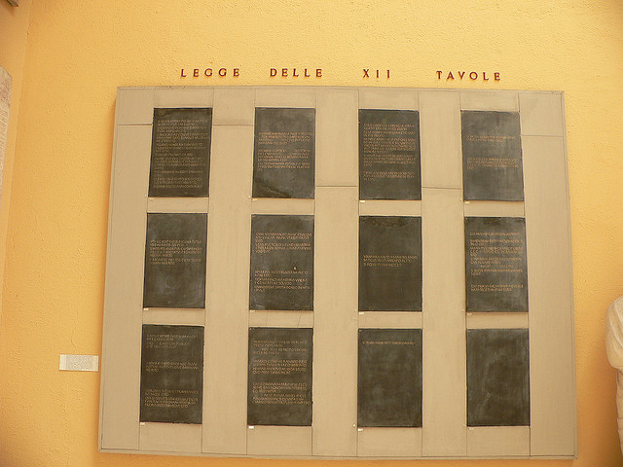
Tension continues
Tension between the plebs and the aristocrats continued. At least during the monarchy a pleb could appeal to the king. The Roman magistrates changed ever year which was not conducive for a good appeal system.
In 452 BCE, the Romans created a board of ten aristocrats called decemvirs to establish a set of laws called the Twelve Tables to display the laws at the request of the plebs.
Headed by Appius Claudius Decemvir headed the commission, which enjoyed virtually unlimited authority. Appius Claudius was erased from history after abusing this power after the tables were displayed in 449 BCE

Slide 20
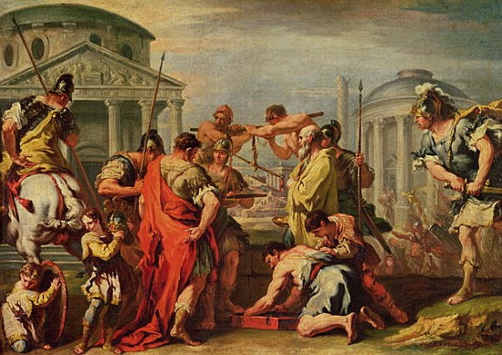
2nd dictator: Marcus furius Camillus
50 years later, the difficult task of taking the neighboring Etruscan tribes was given to Camillus.
Camillus observed that his ten-year siege of Veii showed little result, but noticed that the people of Veii could never be taken as long as their Lake Albanus still had water.
Camillus drained the lake and took the city from its defenders.
Thus began Roman expansionism.

Slide 21
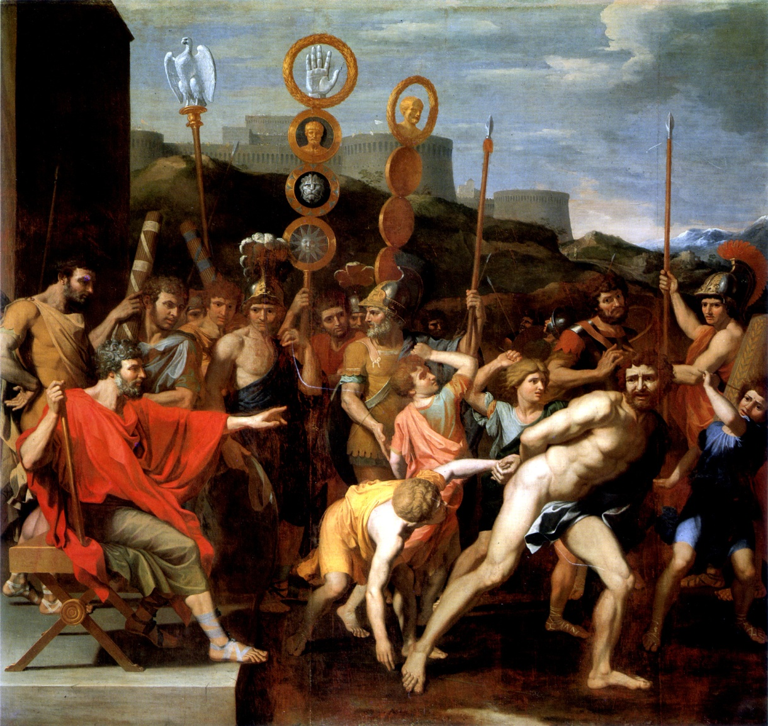
Camillus’ siege of the etruscan city of falerii
Soon, Camillus moved on to siege the Etruscan city of Falerii
There Camillus meet a witty school teacher who brought the sons of the leaders to his camp. He would agree to exchange the children for gold.
Refusing the terms, Camillus claimed that the Army of the Roman People did not wage war on children and he had them sent back to their parents.
Having been amazed by their enemies’ generosity, the parents of the children agreed to surrender the city.

Slide 22
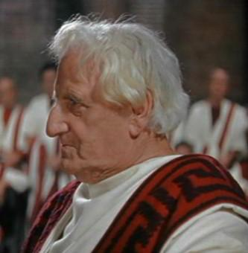
Camillus’ exile
The Romans were very pleased with Camillus because of his ability to win wars in unusual wars which preserved both materials and men.
However, soon Camillus became out of favor with the people. He rode white horses in his Triumphs, something which was symbolic of the gods.
It was also suspected that the loot of his army was not being distributed evenly.
Camillus was exiled.

Slide 23
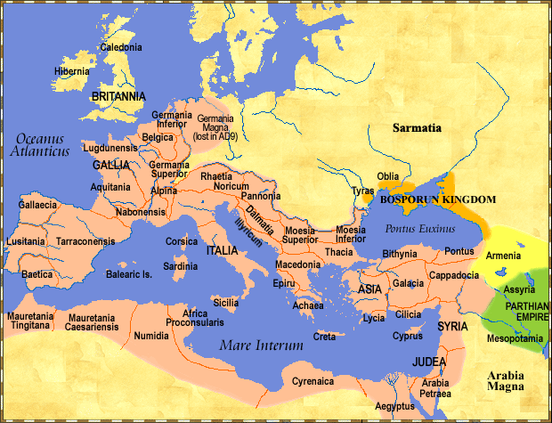
Conflict with the gauls
Camillus’ exile came at a terrible time. The conquering of the neighboring Etruscan tribes removed a barrier between Rome and Gaul.
In 390 BCE, the Gauls defeated the Romans at the river Allia. The Romans fled back to the citadel on the Capitoline Hill. Surrounded, the Romans seemed to be doomed.
Swallowing his resentment, Camillus raised a neighboring army and sent aid to the Romans
For rescuing the Romans, Livy game Camillus the title “parens patriae conditorque alter urbis”; founder of the country and second father of his country.
Camillus’ reputation served as an example of Roman honor for future generations.

Slide 24
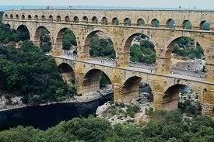
Appius claudius “caecus”
An esteemed member of the Claudii gens.
From 312 -285 BCE he served as censor, consul, and dictator.
Built the Via Appia which stretches from Rome to Capua.
Also known for building the Aqua Appia, Rome’s first aqueduct.
He also gave voting privileges to common men and made publicly transparent the laws, calendars, and procedures of the priests which were kept in secret.

Slide 25
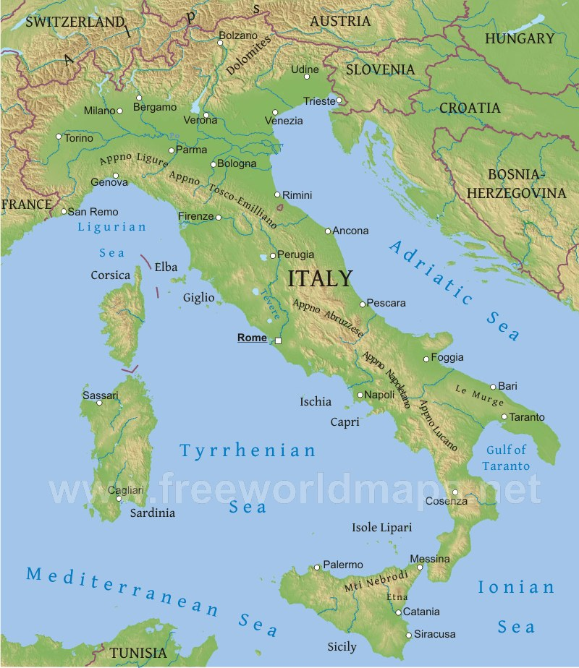
Roman expanionism
Rome gradually grew throughout the Italian peninsula, conquering neighboring tribes and city states.
Consider how Rome’s geography make’s her a suitable dominant power in Italy.
The Romans usually taxed these people, but not unbearably.
The Greek city state of Tarentum treated Roman representatives poorly and asked for aid from King Pyrrhus of Epirus. In 280 BCE, Pyrrhus, Rome’s first non Italian enemy defeated her by using elephants in battle.

Slide 26

Kings Pyrrhus
Impressed that all Roman soldiers suffered wounds on their front, he agreed to return Roman prisoners which he salvaged.
The Roman consul Fabricius was sent to Epirus to discuss the matter. Observing the courage of Fabricius, he accepted no bribes and flinched at no threats (Pyrrhus trumpeted an elephant behind him), Epirus returned the Roman captives to Fabricius recognizing that they had little value.
Thinking that Fabricius was the last man in Rome of such quality, he tried to take advantage of what he thought was a vulnerable situation.

Slide 27
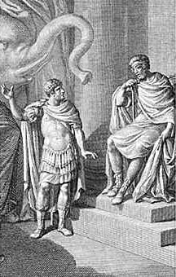
cineas
Pyrrhus sent his best orator, Cineas, to address the Roman Senate.
While Cineas spoke, Claudius Appius walked in and gave the first recorded speech in Latin. Through this speech he gave us the saying “every man is the architect of his own fortune”. This meant that if the senators did not see that Rome could and must fight off Pyrrhus, then they were blinder than he was.
The Senators sent Cineas back to Pyrrhus, signifying that Fabricius was not the last Roman with audacity and courage.

Slide 28
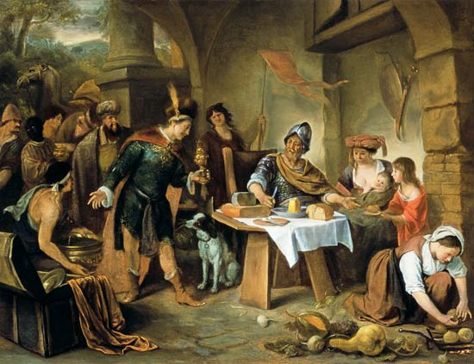
dentatus
Wasting little time, the Romans elected Fabricius as consul in 282 BCE where he defeated several neighboring enemies.
Fabricius was successful in his campaign against Pyrrhus. Fabricius returned the doctor of Pyrrhus who tried to bribe Fabricius to poison off his own king.
Dentatus was responsible for the final Roman victory over Pyrhhus in 275.
Pyrrhus later died by a roof tile thrown by a woman who apparently was not an admirer of his.

Slide 29
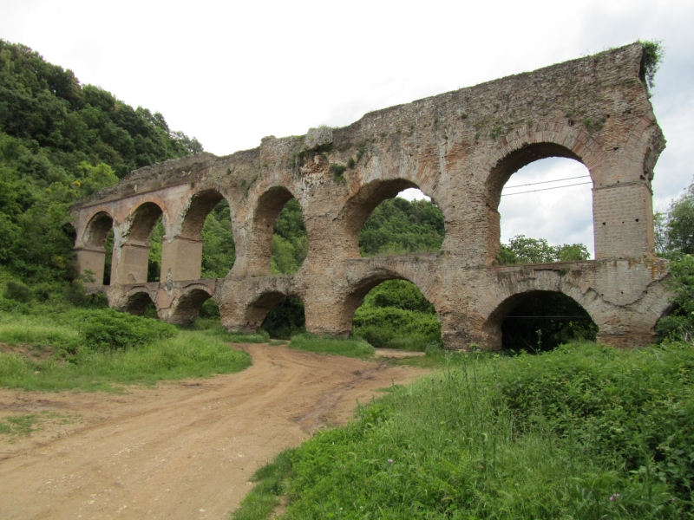
Dentatus
Dentatus became the first non aristocratic consul elected in 290 BCE. He made Roman enemies wish that they had picked on someone else; two of the worst being the Samnites and the Sabines.
The Samnites came to Dentatus with a bribery of gold one evening while he was cutting turnips in a pot. They hope that he would either switch sides or throw the contest.
He claimed to the Samnites that he enjoyed his mundane lifestyle and said that he would rather control against those who have the gold rather than those who shine it.
He defeated Rome’s enemies time and time again and built the second Roman aqueduct, the Anio Vetus .

Slide 30
Next time…
The Romans begin to extend themselves southward to the southern island of Sicily.
While there, they meet a group of people from North Africa known as the Carthaginians (Poeni in Latin for they came from Phoenicia).
In 265 BCE the Romans find themselves involved in affairs outside of the Italian peninsula.

