Slide 1
Latin I: Chapter I
“Romulus and Remus”
Parts of Speech
Nouns: Number, Gender, Case (Nominative and Accusative)
First Declension Nouns

Slide 2
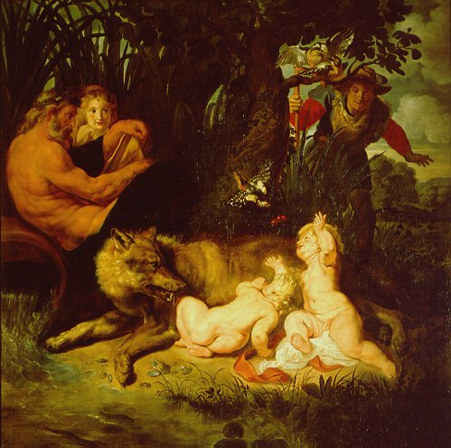
Memorābile Dictū: SPQR: Senātus Populusque Rōmānus

Slide 3
Translate the Story on pg. 2
In small groups
Read Reading section at the top of the page
Use the vocabulary on pgs. 3 and 5
Read Language Fact II (pg. 6) and Language Fact III (pg. 9)
When you are all finished, we will discuss the grammar and theVocabulary to Learn (pg. 5). Then we will go over the story together.

Slide 4
Parts of Speech (page 4)
Noun
Pronoun
Adjective
Adverb
Verb
Preposition
Conjunction
Interjection

Slide 5
Nouns: Case, Number, and Gender
In Latin, ALL nouns have three basic properties. For each Latin noun that you see in a given translation, you must know these three main properties of that noun:
Case
Number
Gender

Slide 6
Case
The Case determines the grammatical function of the noun. In Latin there are seven cases, five of which are regular.
Nominative
Genitive
Dative
Accusative
Ablative
In Latin, case is indicated by a special inflectional ending based upon a nouns declension.

Slide 7
Case: Nominative
Nominative: The nominative case is used for the subject in a sentence as well as the predicative nominative and predicate adjective.
The Subject in a sentence always performs the action of the verb.
For example: Find the subject in the following sentence
She gave flowers to her Mother on Mother’s Day.

Slide 8
Case: Nominative
The Predicate Nominative and the Predicate Adjective always follow a form of the verb to be (e.g. is, was, were, etc.) when it is the main verb in the sentences and equates to the subject (i.e. they tell you to what the subject is equal). The only difference between the two is that the Predicate Nominative is always a noun and the Predicate Adjective is always an adjective.
For example: Find the predicate nominative and the predicate adjective in the following sentences:
Those boys and girls are runners.
My mother is very smart.

Slide 9
Case: Accusative
The Accusative case is used for the Direct Object in a sentence and sometimes the object of a prepositional phrase.
The direct object always receives the action of the verb. It is the opposite of the subject.
For example: Find the direct object in the following sentence.
My dog ate my homework.

Slide 10
Case in English
Do we use cases in English? If so, how do we recognize them?

Slide 11
Number
Number indicates whether a noun is singular or plural.
Do we use number in English? How?

Slide 12
Gender
In Latin, there are three genders: Masculine, Feminine, and Neuter. The gender for each noun see in translation must be known.
There are two ways to determine the gender of a noun in Latin:
Gender by Nature: obviously mater is feminine
Grammatical Gender: randomly selected

Slide 13
Declension
A declension is simply a group of nouns. In Latin, there are five declensions. Each declension has its own set of inflectional endings. These endings MUST be memorized.
Almost all nouns belonging to a specific declension share a similar gender.

Slide 14
1st Declension: Puella, puellae (f)- Girl
Singular Plural
Nominative Puella Puellae
Genitive Puellae Puellārum
Dative Puellae Puellīs
Accusative Puellam Puellās
Ablative Puellā Puellīs

Slide 15
1st Declension: Gender
Almost all 1st declension nouns are feminine in gender.
However, those nouns that are occupations or show agency are masculine

Slide 16
Determining that a noun is first declension
To determine if a noun belongs to the 1st declension, look at the genitive singular ending (the second word in the sequence given to you in the vocabulary list).
If that noun ends in an –ae, then that noun belongs to the 1st declension and can only have 1st declension endings.

Slide 17
Declining a noun
In order to decline the noun, you must first find the stem. To find the stem, go to the genitive singular case and remove its ending. Whatever is left is the stem.
For example: Aqua, aquae (f)- water
Remove the ae from aquae and you have aqu-.
Write out the stem ten times (one for each noun in its case per each number).
Finally, add the inflectional endings.

Slide 18
Declining a noun: Step 1
Remove the –ae from the genitive singular
Aqua, aquae (f)- water
Aqu

Slide 19
Declining a noun: Step 2
Write out the stem ten times (once per each case per each number).
Singular Plural
Nominative Aqu Aqu
Genitive Aqu Aqu
Dative Aqu Aqu
Accusative Aqu Aqu
Ablative Aqu Aqu

Slide 20
Declining a noun: Step 3
Add the inflectional endings for that declension. Remember the declension is determined by the genitive singular ending.
Singular Plural
Nominative Aqua Aquae
Genitive Aquae Aquārum
Dative Aquae Aquīs
Accusative Aquam Aquās
Ablative Aquā Aquīs

Slide 21
Vocabulary to Learn
For nouns…
1st word = nominative singular
2nd word = genitive singular (used to find stem and determine noun’s declension)
3rd- Gender
4th- Denotation

Slide 22
Vocabulary to Learn Ch. 1
Pg. 5
This is the vocabulary that you must learn for vocabulary quizzes.
For nouns you must know the following information:
Nominative singular
Genitive singular
Gender
Definition

